Slide 1




Apache Footwear India Private Limited
The
Prototype for
Cutting Material Management
Report Presented
Presented by : Manohar-g ( APC-IT )
2025 July 01

Slide 2
Key Responsibilities for Cutting Material Management
BOM Department – Enhancing Accuracy and Efficiency :
1 . Ensure Accuracy in BOM Pulling
2 . Create BOM Based on Actual Article Usage 3 . Avoid Unnecessary Material Creation
Pull BOM
Purchase Department – Ensuring Timely and Aligned Procurement
Procure Based on Finalized BOM Requirements
Monitor Material Lead Times Proactively
Avoid Over-Purchasing or Excess Inventory
Purchase Department
Warehouse Department – Maintaining Data Accuracy and Stock Readiness
Ensure Accurate Stock Data Maintenance
Fetch and Share Stock Data Correctly
Support Cutting Material Availability Checks
Warehouse Department
Planning Department – Driving Accurate Schedules and Coordination
Maintain Accurate Planning Data
Update Schedules Promptly
Coordinate Closely with Other Departments
Escalate Issues Proactively
Planning Department
Production Department – Ensuring Smooth Execution and Timely Output
Follow Updated Cutting and Production Plans
Communicate Line Stoppages Immediately
Track and Share Real-Time Progress
Production

Slide 3
Organizational Workflow for Cutting Material Monitoring & Escalation
View overall readiness %, material trends, escalations
GM ( Top Management )
Sees high-level overview
Ensure BOM is accurate, validate material need, resolve errors
Track PO-wise readiness, material issues, escalate to teams
Check assigned POs, start cutting only if fully ready, escalate
Planning Team
Plant In-charge
Line Supervisor
shares
Assigns
Track PO readiness
Manage escalations
Coordinate departments
Executes cutting plan
Raise real-time issues
Escalate shortages
Track Purchase Status
Issue materials, verify stock
Purchase Team
Cutting Material Report
Warehouse Team
Supplies
Supplies
Data
Material Issue

Slide 4
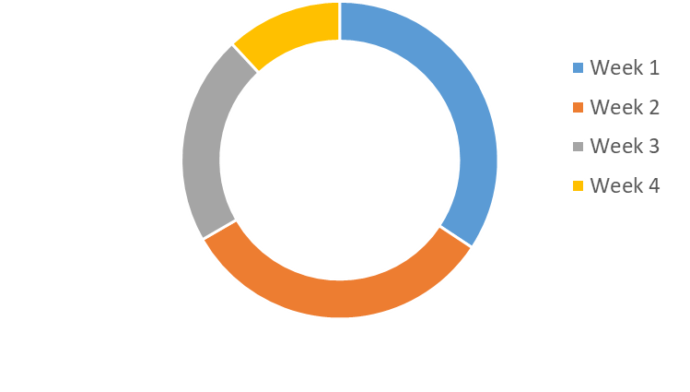
Cutting Material Availability Dashboard ( For General Manager – GM )
Date Range
Plant
2025/07/01
All
Line
Submit
All
📦 Material Readiness %
82% Ready
🚨 Open Escalations (issues not yet resolved)
5
📋 Total POs Today
36
📈 Avg Delay
2.1 days
Purpose: Compare different plants to see which ones are better prepared for cutting.
Description : Shows % of material availability across all assigned POs
Benefits : Identify which plant is performing well and where attention or escalation is needed.
Top 5 Short Materials :
Material | Short Quantity | Affected Pos
FTWR WHITE 01F7 54 | 340m | 3
1.4MM ECO SOFT MATTE | 220m | 8
CEMENT TWICE | 165m | 21
WHITE LATEX | 100m | 4
ST-A990-06E EPM5 MESH | 92m | 1
Purpose: Highlight the most frequently short or unavailable materials, across all POs.
Benefits : Quickly identify which raw materials are causing the biggest disruptions—helps guide procurement priorities
Cutting Availability Trend ( Weekly ) ( Line Wise )
Purpose: Visualize the trend of material readiness over time
Benefits : Spot improvement or decline in readiness over time. A dropping trend might signal deeper issues in supply or coordination.

Slide 5
Cutting Material Availability Dashboard ( For General Manager – GM )
Critical Escalated Pos :
PO NO
Plant
Status
All
All
All
Submit
PO NO | Plant | Shortage | Delay | Escalated To | Status
1000042525 | Plant B | Fabric A | 3d | Planning Team | ⚠ Pending
1000042579 | Plant E | Material 2 | 2d | Purchase Team | ✅ Resolved
1000042587 | Plant H | Material 3 | 6d | Warehouse Team | ✅ Resolved
1000042592 | Plant K | Material 4 | 1d | Planning Team | ✅ Resolved
1000042466 | Plant F | Material 9 | 5d | Purchase Team | ⚠ Pending
Purpose: Highlight urgent POs that are delayed due to material unavailability and require attention.
Benefits : Spot improvement or decline in readiness over time. A dropping trend might signal deeper issues in supply or coordination.
Explanation For KPI Cards
Purpose: Give an instant overview of today’s key metrics
KPI | Description
📦 Material Readiness % | % of POs for which all required materials are 100% available. Shows overall cutting readiness.
🚨 Open Escalations | Total number of escalated cases (shortage or delay) not yet resolved. Reflects risk and follow-up need.
📋 Total POs Today | Number of POs scheduled for cutting today. Shows daily load.
📈 Average Delay | Average days of delay for POs with shortages. Helps GM assess the severity.
Benefits : Quick health check of plant’s material readiness and performance for the day.

Slide 6
Cutting Material Availability – Plant In-chart Dashboard
Date Range
Line
PO NO
2025/07/01
All
Plant
All
All
Status
All
📋 Total POs Today
28
✅ Fully Ready Pos
19
🚫 Shortage Pos
7
🔁 Delayed Pos
2
PO-Wise Material Readiness Status
Date | PO NO | Model | Plant | Line | Material Readiness % | Status | Delay | Action
2025/07/02 | 1000042579 | SAMBA | AP11 | AP11C02 | 100% | ✅ Ready | - | Start Cutting
 | 1000042525 | STANSMITH | AP10 | AP10C04 | 75% | ❌ Short | 1 DAY | Escalate
 | 1000215486 | ULTIMATE | AP09 | AP09CO3 | 90% | ⚠ Partial
Check
Material Shortage Tracker
Material Name | Required Qty | Available Qty | Short Qty
Fabric A | 200m | 160m | 40m
Purpose: Core operational view—monitor each PO’s readiness at the line level and Material-wise breakdown of what’s short and how many POs are impacted..
Benefits : Take immediate steps for POs with issues and Communicate to purchase team or prioritize allocation from existing stock.

Slide 7
Cutting Material Availability – Line Supervisor Dashboard
Day
PO NO
2025/07/05
All
Status
Line
All
All
📋 Assigned Pos
5
✅ Ready to Cutting
3
❌ Not Ready
1
⚠ Escalated
1
PO Readiness List
Day | Line | PO NO | Article | Material Status
2025/07/05 | AP11CO5 | 1000042525 | Samba | ✅ OK
 |  | 1000042579 | Samba | ❌ Short
Check
Check
Material Checklist by PO
PO NO
By default the field takes short material status po in ascending order
1000042579
PO NO | Article | Material | Material Name | Required Qty | Available Qty | Shortage Qty | Status | Invoice | ETA
1000206709 | Samba | M001 | Material 1 | 125 | 125 | 0 | ✅ OK
1000206709 | Samba | M002 | Material 2 | 520 | 300 | 220 | ❌ Short | INV-MAT-20240620-0048 | 2025/07/05
Raise Escalations
PO NO
1000042579
Issue
Submit
Enter Issue
Request store verification
PO NO
Check
1000042579

Slide 8
Explanation For KPI Cards
Purpose: Instant visibility into current day’s assigned work.
KPI | Description
📋 Assigned POs | Total number of POs assigned to this line
✅ Ready to Cut | Number of POs where all required materials are ready
❌ Not Ready | POs with pending material issues
⚠️ Escalated | POs where supervisor has already escalated an issue
Actionable Insight: Helps supervisor prioritize which POs to act on immediately.
Explanation For Raise Escalations and Request Escalations
Purpose: Give tools to take quick actions when problems arise.
Tool | Purpose
Raise Escalation | Supervisor can raise issue to planning/store/purchase with comments
Request Store Check | Ask store to recheck or confirm material
Actionable Insight: Reduces delay and increases ownership.

Slide 9
Planning , Warehouse , Purchase Department Dashboard
PO Material Allocation View
Day | PO NO | Article | BOM | PURCHASE | WAREHOUSE | STATUS
2025/07/02 | 1000206709 | Samba | ✅ Yes | ✔ Ordered | ✅ Not Ok | ❌ Short
 | 1000042525 | Stan smith | ✅ Yes | ✔ Ordered | ✅ Ok | ✅ Ok
Check
PO | Material | Required Qty | Available qty | Shortage qty | Ordered qty | invoice | ETA
1000206709 | M01 | 125 | 125 | 0 | 0 | - | -
1000206709 | M02 | 258 | 220 | 38 | 38 | INV-MAT-20240620 | 2025/07/05
Filters :
Day
2025/07/05
1000042579
PO NO

Slide 10
Mail Escalations And Whatsapp Escalations
Escalation Type | Trigger Condition | Target Department | Medium
Material Shortage Alert | Required material not available in stock & no PO before CRD | Purchase, Warehouse | Email, WhatsApp
Delayed PO Delivery | PO delivery date exceeds CRD or cutting plan date | Purchase | Email, WhatsApp
Cutting Plan at Risk | Material not ready 2 days before scheduled cutting | Planning, Production | WhatsApp
Line Stoppage Notification | Production halted due to missing material | Planning, Purchase, Warehouse | Email
Material Fetch Delay | Material request issued but not fetched from warehouse | Warehouse | WhatsApp
Schedule Escalation | Cutting not started on planned date | Planning | Email

Slide 11



